Slide 1
Introduction to Humanities Programming
Programming Concepts

Slide 2

What does it mean?

Slide 3

Why Program?
Applications come from the needs of the present: your needs
﻿Effectively articulating needs is the first step
Express complex logic and perform computation
Do things that would take a human a long time to do
counting
comparing
repeating

Slide 4
Digital Humanities Programming?
Notes:
What is it? How would they define it?

Slide 5
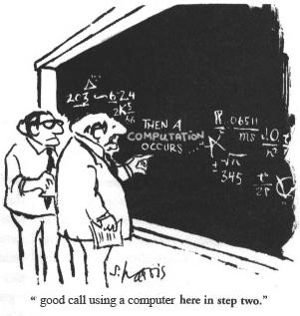
What is a programming language?
An artificial language with a limited purpose
A means of expressing computations (math) and algorithms (logic)

Slide 6
What is a programming language?
...like human languages in some ways!

Slide 7
Syntax (form)
Semantics (meaning)
signs/words (variables, symbols, numbers, strings)
expressions
"flow" (decisions, conditions, loops, narrative)
complex entities (methods, structures, & objects)

Slide 8
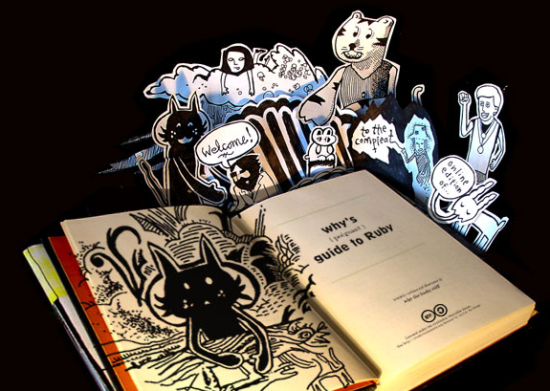
"when you don't create things, you become defined by your tastes rather than ability. your tastes only narrow & exclude people. so create.”
why the lucky stiff (@_why)
Notes:
Translation – get out there and try some stuff!

Slide 9
Language
Code used to create applications
Ruby
PHP
Python
JavaScript
Java
C++
C
many, many more...

Slide 10
Language Choice
Is it “easy” to maintain?
Is the standard library good enough?
What is it generally good for?
Can your team learn it?
Is your team using it?
Can you live with the syntax?
Do you hate it? Are you comfortable with it?

Slide 11
Library
A collection of reusable code to accomplish a generic activity
Date math (three months from today)
Logging
Working with file systems
Compressing files
Ex. - You don’t have to rewrite code to save a file to your drive each time because someone else did it for you!

Slide 12
Python
Python is a language
Packages are Ruby libraries
Rails is a framework
Written in Ruby
Contains many Ruby gems
Used to build web applications
Notes:
Other things to add about it –
It’s monty python
Syntax matters
Good for doing things yourself
Flexible
legible
Difficult to manage installations sometimes

Slide 13
Ruby Philosophy
“Principal of least surprise”
People want to express themselves when they program
People don’t want to fight the language
Programming languages must feel natural

Slide 14
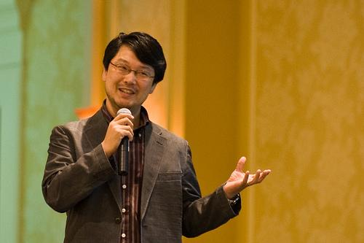
"...trying to make Ruby natural, not simple."
Yukihiro Matsumoto
aka "Matz"

Slide 15
Ruby Philosophy:
“I tried to make people enjoy programming and concentrate on the fun and creative part of programming when they use Ruby”

Slide 16
Ruby Philosophy: applied
Ruby is a humane interface (many ways to do things)
Favors readability and variety over concision and perfection
Sometimes this makes code harder to understand, but usually it’s easier
Contrasts with a minimal interface with one (or very few) “correct” ways to do things

Slide 17
Many Rubies
Ruby 1.0 (1996)
Implementations
MRI
REE
Jruby
Rubinius
MagLev
MacRuby

Slide 18
Many Versions
MRI 1.9.3
MRI 2.1.2
Jruby 1.7.13
…

Slide 19
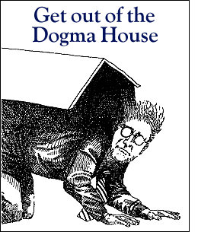
Dogma
Language x is not web-scale
Language x is not enterprise
Language x does not scale
The x framework doesn't handle this weird edge case

Slide 20
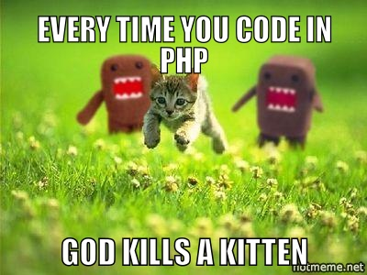

Slide 21
Why Ruby?
General purpose
Usable on your computer or over the web
English-like syntax and useful built-in features
"Fun" to write
Object-oriented

Slide 22
Why Not Ruby?
Not as easy to run on the web as PHP
Used less often than PHP, and major platforms (WordPress, Drupal, Omeka) use PHP
Ruby isn't Rails
Object-oriented languages are conceptually difficult to grasp

Slide 23
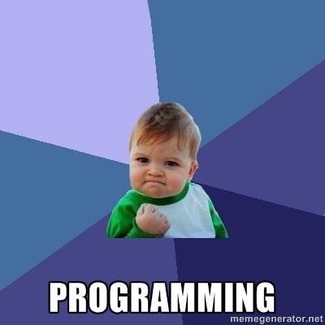
What we will cover
What is a data type?
What is a variable?
What is an operator?

Slide 24
What you will be able to do
create numeric and text information
store information in variables
print information to the screen

Slide 25
Open the Terminal
Windows: git bash
OS X: iTerm2

Slide 26
Prompt
Terminals show a line of text after a command finishes
Whenever instructions start with "$ ", type the rest of the line into the terminal
Let's give the terminal a command to open Interactive Ruby (IRB)
$ irb

Slide 27
irb: Interactive Ruby
IRB has its own prompt with ends with >
$ irb
>
You can use Control + D to exit IRB at any time or type exit on its own line
When in IRB, terminal commands won’t work

Slide 28
Variables
"words" that refer to information

Slide 29
Variables
Give it a name so we can refer to it
It's information can be changed
$ irb
> my_variable = 5
=> 5
> my_other_variable = "Hi"
=> "Hi"
> my_variable = 10
=> 10

Slide 30
What's with => ?
Setting a variable to a value is called "assignment"
What types of information can we hold in a variable?

Slide 31
Variable Assignment
Variables are assigned using a single equals sign (=)
The right side of the equals sign is evaluated first, then assigned to the variable name on the left side of the equals

Slide 32
Variable Assignment
apples = 5
bananas = 10 + 5
fruits = 2 + apples + bananas
bananas = fruits - apples

Slide 33
Variable Naming
all letters (folders)
all numbers (2000)
with an underscore (first_name)
with a dash (last-name)
a number anywhere (l33t)
a number at the start (101dalmations)
a number at the end (starwars2)
Notes:
Alternates good and bad possibilities

Slide 34
Variable Naming
Be descriptive of the “thing”
Notes:
Words generally are better. Someone reading your code should be able to tell what you’re talking about

Slide 35
Errors

Slide 36
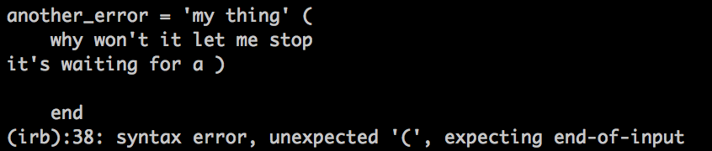
Errors cont.
If it doesn’t seem to be responding
you can always control + d

Slide 37
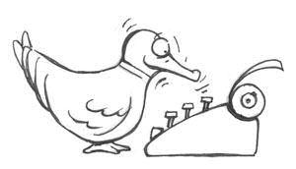
Ruby is a "duck-typed" language

Slide 38
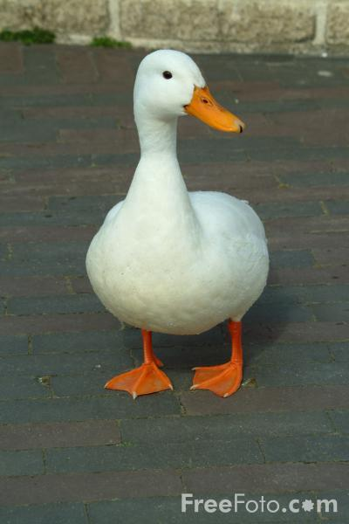
Duck-typing
If it looks like a duck and
it quacks like a duck,
chances are it's a duck.
Notes:
Means that the data types are not explicitly declared as such. We simply assume them to behave properly. And if they don’t they cause errors. So it’s a way of handling the declaration of variables.

Slide 39
Types of ducks
standard types:
numbers & letters
Notes:
characters and words (strings) sometimes two different things, depending on language

Slide 40
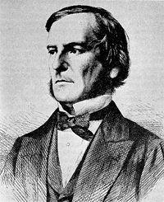
Numbers & Letters
integers:
4, 1040, -55, 9999
floating-point numbers:
1.1, 0.444, 9999.0001, -3.33
text (strings):
"a", 'cat', "The quick brown fox jumped over the lazy dogs.", '8 keys', '7'
boolean (yes or no?):
true, false, 0, 1
Notes:
characters and words (strings) sometimes two different things, depending on language

Slide 41
Strings
Strings are text; it must be wrapped in a matched pair of quotation marks.
$ irb
> 'Single quotes work'
=> "Single quotes work"
> "Double quotes work"
=> "Double quotes work"
> "Start and end have to match'
">

Slide 42
Exercise
Create variables named first_name, last_name, and favorite_color
Assign string values to the variables

Slide 43
Numbers
Numbers without a decimal point are integers
0
-105
898989898
2
-898989898

Slide 44
Numbers
Numbers with decimal points are floating point numbers (floats)
0.0
-105.56
.33
.000004
3.14159265359

Slide 45
Numbers
You can perform operations on both types of numbers
+
-
/
*

Slide 46
Exercise
Try dividing an integer by an integer
Try dividing an integer by a float
How are the results different?
Create two integer variables named num1 and num2 and assign your favorite numbers
Compute the sum, difference, quotient, and product of these two numbers and assign these values to variables named sum, difference, quotient, and product

Slide 47
An answer
num1 = 4
num2 = 5
sum = num1 + num2
difference = num1 - num2
quotient = num1 / num2
product = num1 * num2
Why does quotient = 0 ?

Slide 48
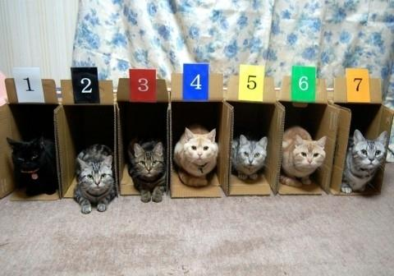
Collections
Notes:
Ways of organizing related groups of information to perform actions on them.

Slide 49
Collections
Collection Types: Array, Hash
Define an Array
Array syntax
Array indexing
Array methods
Definition of a hash
Hash syntax
Hash indexing

Slide 50
Array
An array is a list
Each array is surrounded by square braces (aka square brackets) []
Each element (member) is separated by a comma
> fruits = ["kiwi", "strawberry", "plum"]
=> ["kiwi", "strawberry", "plum"]

Slide 51
Exercise
Make your own array named grocery_list
Include at least 5 items in your grocery list in the array

Slide 52
Array
Indexing
Members are stored in order
Each member can be accessed by its index
Ruby starts counting at zero
> fruits[0]
=> "kiwi"
> fruits[1]
=> "strawberry"
> fruits[2]
=> "plum"
Notes:
Why zero?
How many moves does it take to get to the next one.

Slide 53
Exercise
Still have your grocery_list array?
What is at index zero in your grocery list array?
How about index 5?
Guess the answers and use the syntax examples to see if your guesses are correct
hint: fruits[0]

Slide 54
Hash
In a hash, we can refer to a member by a keyword instead of a number
Each member is a pair
Key: address of the hash member
Value: variable contained by the member, and located by the key name
Other names for a hash:
dictionary
associative array
map

Slide 55
Hash Syntax
Surrounded by curly braces (aka curly brackets) {}
Commas separate each member pair
A key uses => (the rocket) to point to its value
> states = {"VA" => "Virginia", "MD" => "Maryland"}
=> {"VA" => "Virginia", "MD" => "Maryland"}

Slide 56
Exercise
Define a hash named my_info that contains the following keys
first_name
last_name
hometown
favorite_food

Slide 57
Hash Indexing
Member pairs can be accessed by their key
Each key needs to be unique
Values do not need to be unique
states["MD"]
=> "Maryland"

Slide 58
Add A Key
hash["key"] = 2
array[3] = "wayne"

Slide 59
Exercise
Add the key good_food to your my_info hash and give it the same value as your favorite_food key. What happens?
Add a second favorite_food key to your my_info hash. What happens?
Notes:
Keys are overwritten if you use a new one. They have to be unique.
Values on the other hand don’t have to be unique. Multiple keys can have the same value.

Slide 60
Methods
Things that do stuff
Objects (like strings, integers, and hashes) are nouns; methods are verbs
Called (used) with a "."
5.to_s (to_s is the method)
5 + 5 is a shortcut way of writing 5.+(5)
Each data type has a set of built in methods.
See String's methods http://www.ruby-doc.org/core-2.1.2/String.html

Slide 61
Exercise
Create a String variable named old_string and assign it the value "Ruby is cool"
Use String methods to modify the old_string variable to that it is now "LOOC IS YBUR" and assign it to another variable named new_string
Hint: look at the String methods "upcase" and "reverse"

Slide 62
Booleans
A boolean can only have one of two values: true or false
> 1 + 1 == 2
true
> 1 + 1 == 0
=> false
(== means "is equal to;" More on that later...)

Slide 63
Exercise
Create a variable named favorite_color and assign it to your favorite color
Create a variable named not_favorite_color and assign it to a different color
Test if these variables are equal
Is equal to operator is ==

Slide 64
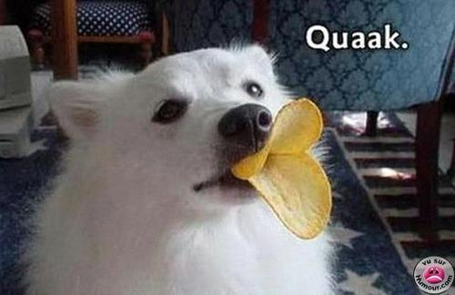
Sometimes there is a problem...
Notes:
With duck typed languages we assume that the variables we are using in particular places can do the things we want. Not always the case. Sometimes we need to change data types.

Slide 65
Casting to appropriate type
to_s (to string)
to_i (to integer)
to_f (guesses?)
Example:
> "3".to_f
=> 3.0

Slide 66
Operators: do stuff with objects
> my_variable + 2
=> 7
> my_variable * 3
=> 15
> my_other_variable + " there!" => "hi there!"
> fruits = fruits + ["lychee"]
=> ["kiwi", "strawberry", "plum", "lychee"]
> fruits = fruits - ["lychee"]
=> ["kiwi", "strawberry", "plum"]
Notes:
"Doing stuff" usually doesn't change the variables used. You'd need to use write things like
new_variable = my_variable + 2
or
my_variable = my_variable + 2
to use this value later.

Slide 67
Exercises
Create an array named vegetables that contain three vegetables you like and one vegetable you don't
Using the vegetables array, create an array named my_vegetables that contains only the vegetables you like
Extra: can you use the first two arrays to create a new array named your_vegetables that only contains the vegetables you don't like?
Notes:
Extra – your_vegetables = vegetables – my_vegetables

Slide 68
Spacing and Legibility
vegetables = ['here', 'are', 'my', 'vegetables']
Vs.
vegetables=['here’, 'are’,'my', 'vegetables']
Keep things regular and neat.

Slide 69
More Operators
+, -, /, * math operators (+ also means concatenation)
= assign a value
+= addition, then assignment
|| or
&& and
== equal
!= not equal

Slide 70
Printing things to the screen
puts "Doctor Who"
doctors = ['Matt Smith', 'David Tennent']
puts doctors[0]
best_episode = 'Blink'
puts "My favorite episode is " + best_episode
puts "My favorite Doctor is " + doctors[1]

Slide 71
Code Exercise 1
Store your street address, city, state, and zip code in variables (or even better, a hash!), then print them in the usual format:
Brandon Walsh
123 My Street
Charlottesville, VA 22903

Slide 72
An Answer
address = {
'name' => Ethan Reed',
'street' => '123 My Street',
'city' => Charlottesville',
'state' => 'VA',
'zip' => 22903'
}
puts address['name']
puts address['street']
puts address['city'] + ', ' + address['state'] + ' ' + address['zip']
Notes:
Other options?

Slide 73
Code Exercise 1
Write a program that converts seconds to years. Test your program with 600000000 seconds, 60 seconds, and 40000.33 seconds.

Slide 74
An Approach
Figure out how many seconds in a year
60 seconds in a minute
60 minutes in an hour
24 hours in a day
365 days in a year (365.242 if you're really precise)
Do the math
Return a result

Slide 75
An Answer
sec = 600000000.0
puts sec/60/60/24/365

Slide 76
Resources
Rubylearning.com
Learn to Program (http://pine.fm/LearnToProgram/)
Why's Poignant Guide to Ruby (http://mislav.uniqpath.com/poignant-guide/)
Ruby Documentation (http://ruby-doc.org/core/)
"Pick-axe Book" (http://ruby-doc.org/docs/ProgrammingRuby/)

